Slide 1
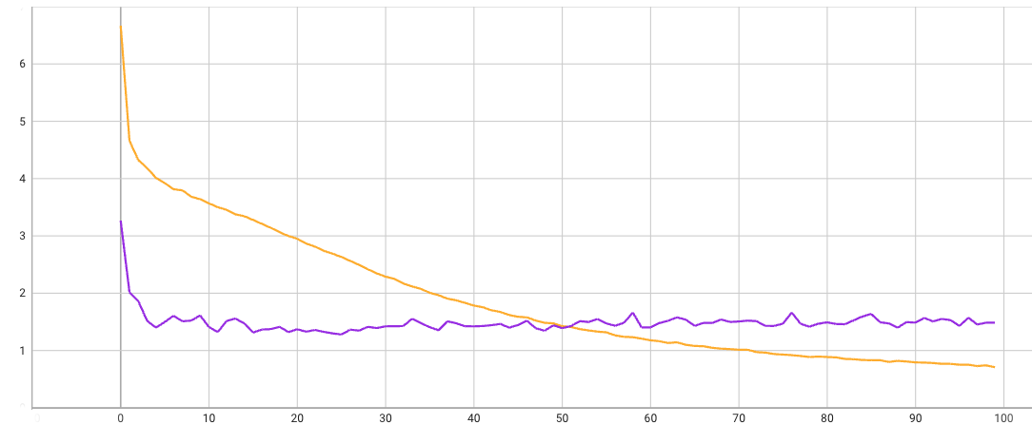
Loss over learning
Train loss
Test loss
Loss
Epochs

Slide 2
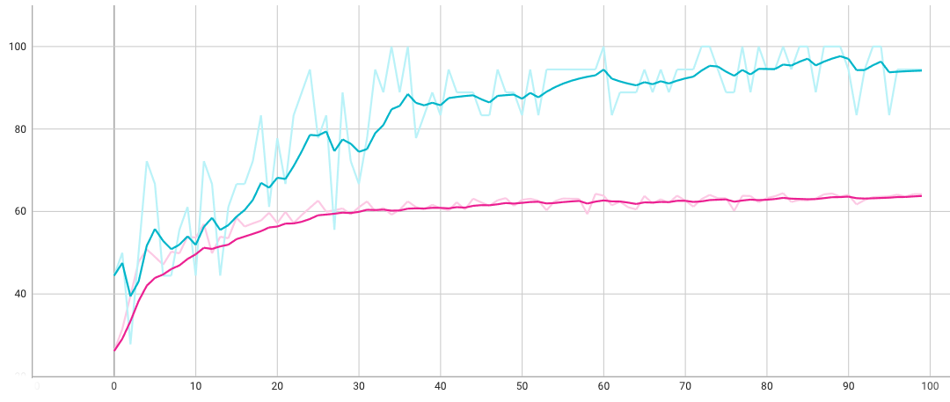
Accuracy over learning
Loss
Training accuracy
Test accuracy
Epochs

Slide 4
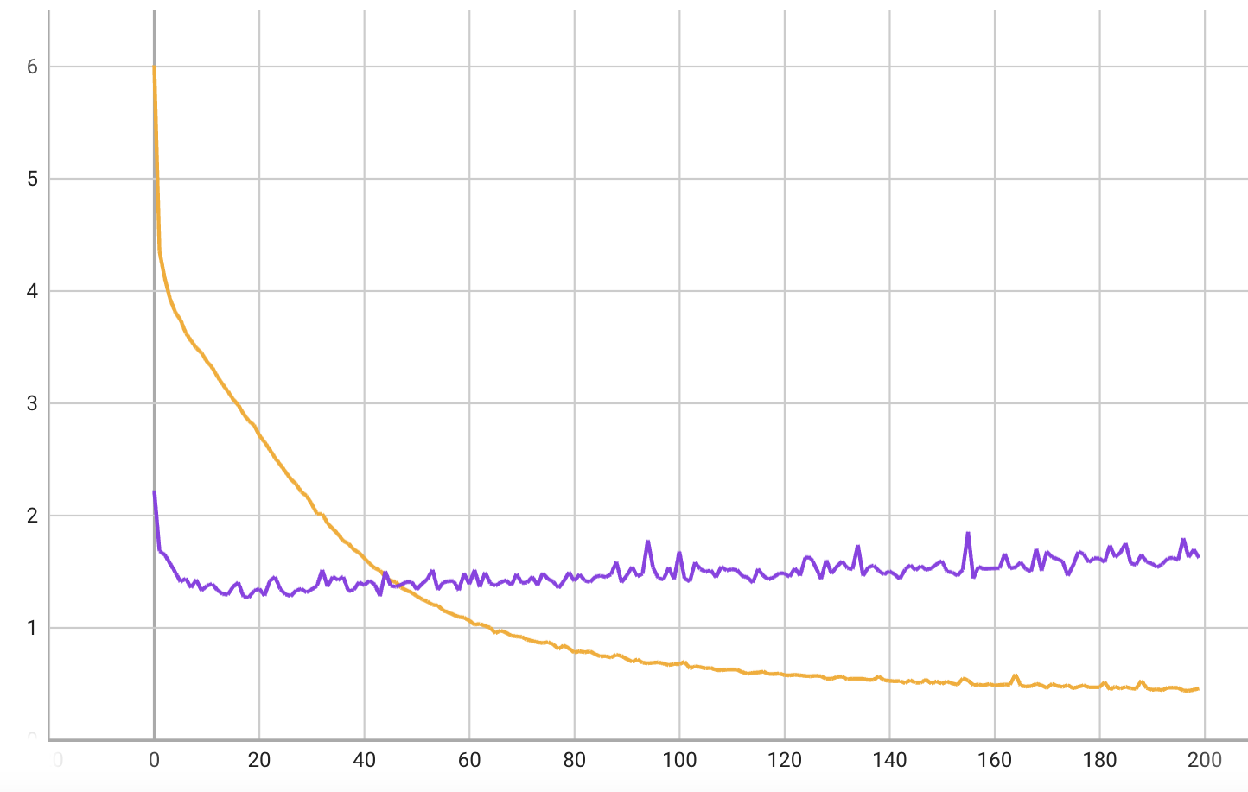
Loss over learning
Train loss
Test loss
Loss
Epochs

Slide 5
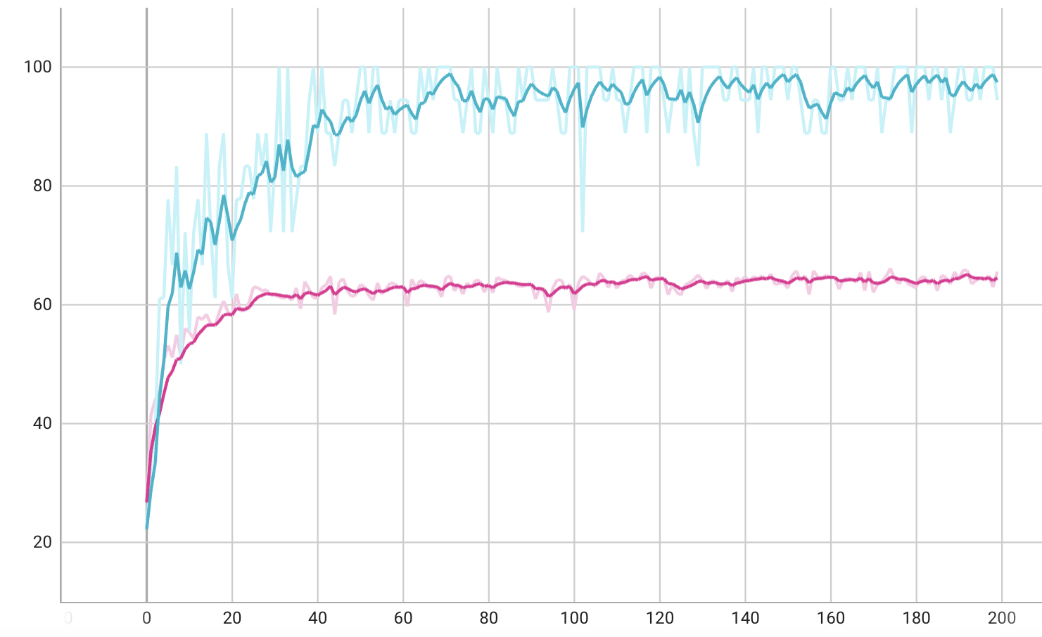
Accuracy over learning
Accuracy
Training accuracy
Test accuracy
Epochs

